Slide 1


THE NATIONAL INSTITUTE OF ENGINEERING , MYSURU
A Mini-Project based on
Image steganography
a GUI based program using Python
- Batch A26 :
Manoj N G
Sohail Maidargi
4NI18EC039
4NI18EC088

Slide 2
Abstract
Steganography is the art of hiding the fact that communication is taking place, by hiding information in other information. Many diﬀerent carrier ﬁle formats can be used, but digital images are the most popular because of their frequency on the Internet. For hiding secret information in images, there exists a large variety of steganography techniques some are more complex than others and all of them have respective strong and weak points. Diﬀerent applications have diﬀerent requirements of the steganography technique used .
This project hides the message with in the image . For a more secure approach, the project it allows user to choose the bits for replacement with LSB replacement from the image. sender select the cover image with the secret text or text ﬁle and hide it in to the image with the bit replacement choice, it help to generate the secure stego image .the stego image is sent to the destination with the help of private or public communication network . on the other side i.e. receiver. receiver download the stego image and using the software retrieve the secret text hidden in the stego image .
So , this is a demonstrative program done using python language along with GUI interface called as STEGIT .

Slide 3
Objective and
problem statement
Today the world is witnessing a data explosion like never before. The amount of data we produce every day is truly mind-boggling. The Forbes article “How Much Data Do We Create Every Day?” states that there are about 2.5 quintillion bytes of data created each day at our current pace, but that pace is only accelerating with the growth of the Internet of Things (IoT). Over the last two years alone 90 percent of the data in the world was generated.
With the fast pace advancement in technology and use of data for continuous innovation it has become our topmost priority to secure data. The protection of data is the primary concern of the sender and it is really important that we encrypt our message in a secret way that only the receiver is able to understand.

Slide 4
Literature Review
“Data hiding using Image Steganography” by Nannpaneni Manoj kumar ,
M.Praveen kumar , M.Srinivasa Roa .
- available online at www.ijarnd.com
A research article on “Hide and encryption fingerprint image by using LSB and transposition pixel by spiral method” by Hyder Yahya
- published in IJCSMC , vol. 3 , pg.624-632 , December 2014 .
“A stenography application for hiding student information into an image” by Yildiray and Murat Karabatak .

Slide 5
Introduction
What is Steganography?
Steganography is the process of hiding a secret message within a larger one in such a way that someone can not know the presence or contents of the hidden message. The purpose of Steganography is to maintain secret communication between two parties. Unlike cryptography, which conceals the contents of a secret message, steganography conceals the very fact that a message is communicated. Although steganography differs from cryptography, there are many analogies between the two, and some authors classify steganography as a form of cryptography since hidden communication is a type of secret message.
Types of Steganography
Steganography works have been carried out on different transmission media like images, video, text, or audio.

Slide 6
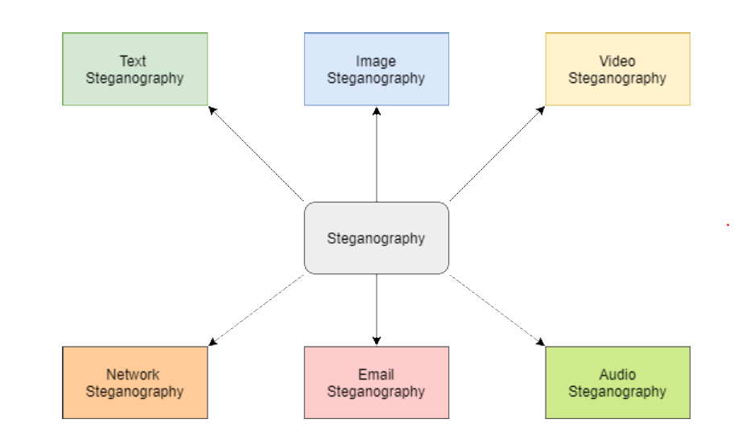

Slide 7
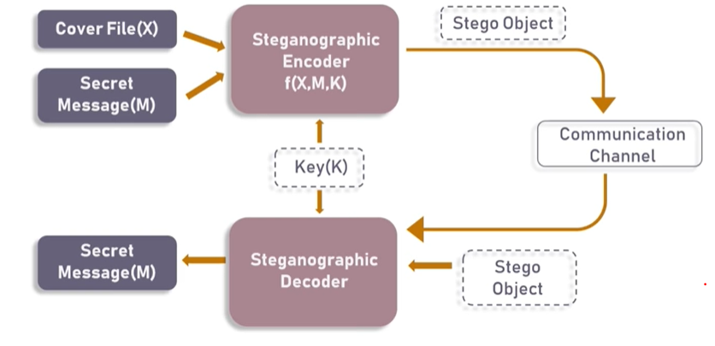
Basic Steganographic model

Slide 8
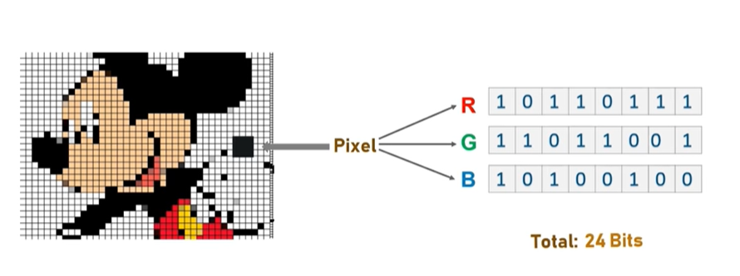
Least Significant Bit (LSB) Steganography
We can describe a digital image as a finite set of digital values, called pixels. Pixels are the smallest individual element of an image, holding values that represent the brightness of a given colour at any specific point. So we can think of an image as a matrix (or a two-dimensional array) of pixels which contains a fixed number of rows and columns.
Least Significant Bit (LSB) is a technique in which the last bit of each pixel is modified and replaced with the secret message’s data bit.

Slide 9
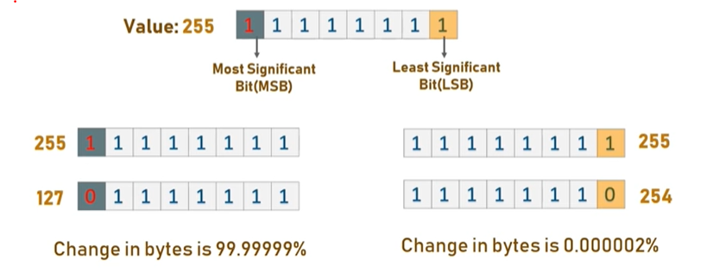
From the above image it is clear that, if we change MSB it will have a larger impact on the final value but if we change the LSB the impact on the final value is minimal, thus we use least significant bit steganography.
How LSB technique works?
Each pixel contains three values which are Red, Green, Blue, these values range from 0 to 255, in other words, they are 8-bit values. [4] Let’s take an example of how this technique works, suppose you want to hide the message “hi” into a 4x4 image which has the following pixel values:
[(225, 12, 99), (155, 2, 50), (99, 51, 15), (15, 55, 22),(155, 61, 87), (63, 30, 17), (1, 55, 19), (99, 81, 66),(219, 77, 91), (69, 39, 50), (18, 200, 33), (25, 54, 190)]

Slide 10
Using the ASCII table , we can convert the secret message into decimal values and then into binary: 0110100 0110101.Now, we iterate over the pixel values one by one, after converting them to binary, we replace each least significant bit with that message bits sequentially (e.g. 225 is 11100001, we replace the last bit, the bit in the right (1) with the first data bit (0) and so on).This will only modify the pixel values by +1 or -1 which is not noticeable at all. The resulting pixel values after performing LSBS is as shown below:
[(224, 13, 99),(154, 3, 50),(98, 50, 15),(15, 54, 23),(154, 61, 87),(63, 30, 17),(1, 55, 19),(99, 81, 66),(219, 77, 91),(69, 39, 50),(18, 200, 33),(25, 54, 190)]
Methodologies
Stegit , a graphical user interface .
Sqlite3 , a C library that provides a lightweight disk-based database .
LSB algorithm , an algorithm for encoding and decoding images .

Slide 11
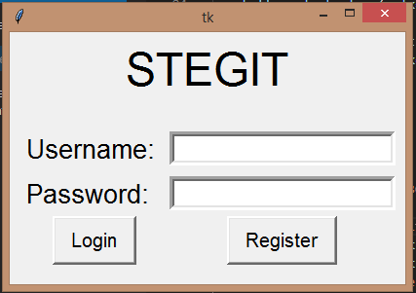
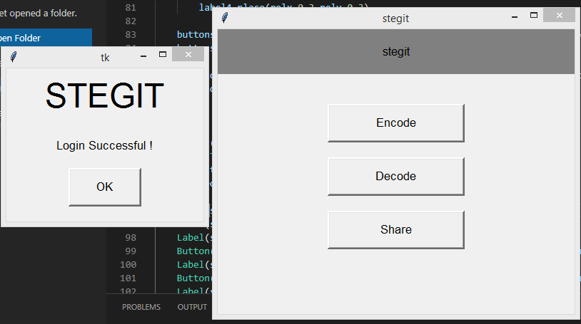
System design
Developing a GUI called STEGIT program using codes in python language
and Tkinter library functions .
Expected outcomes

Slide 12
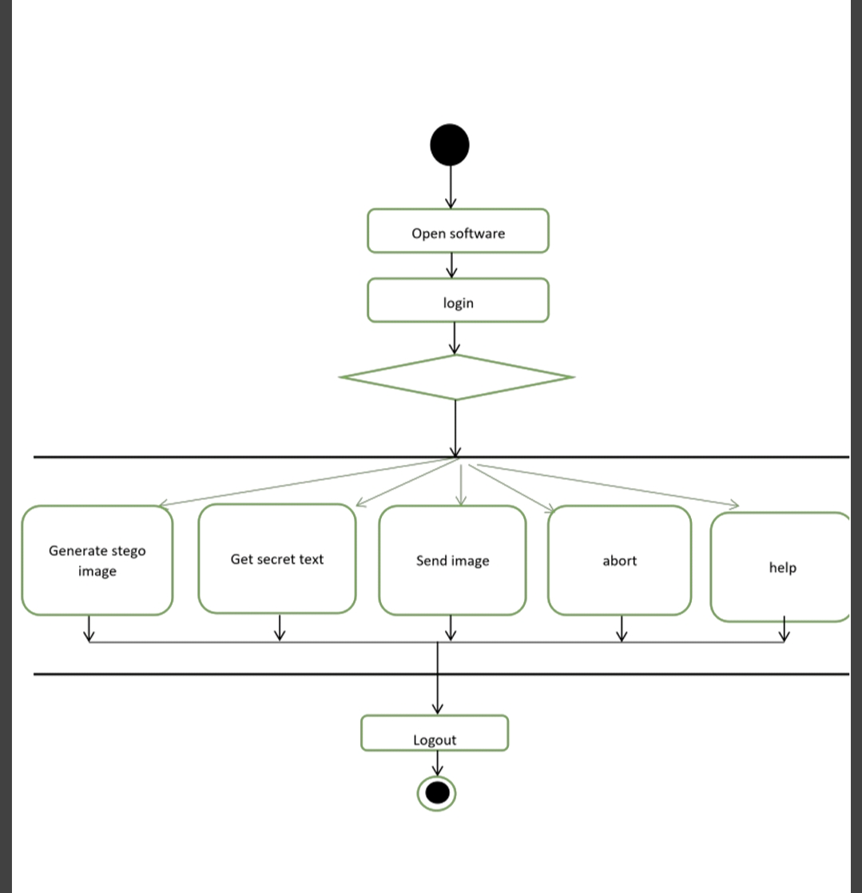
Procedure to use the system :
no
Credentials
yes

Slide 13
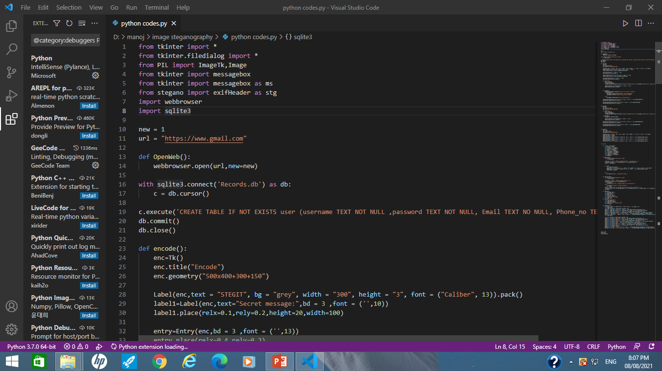
codes

Slide 14
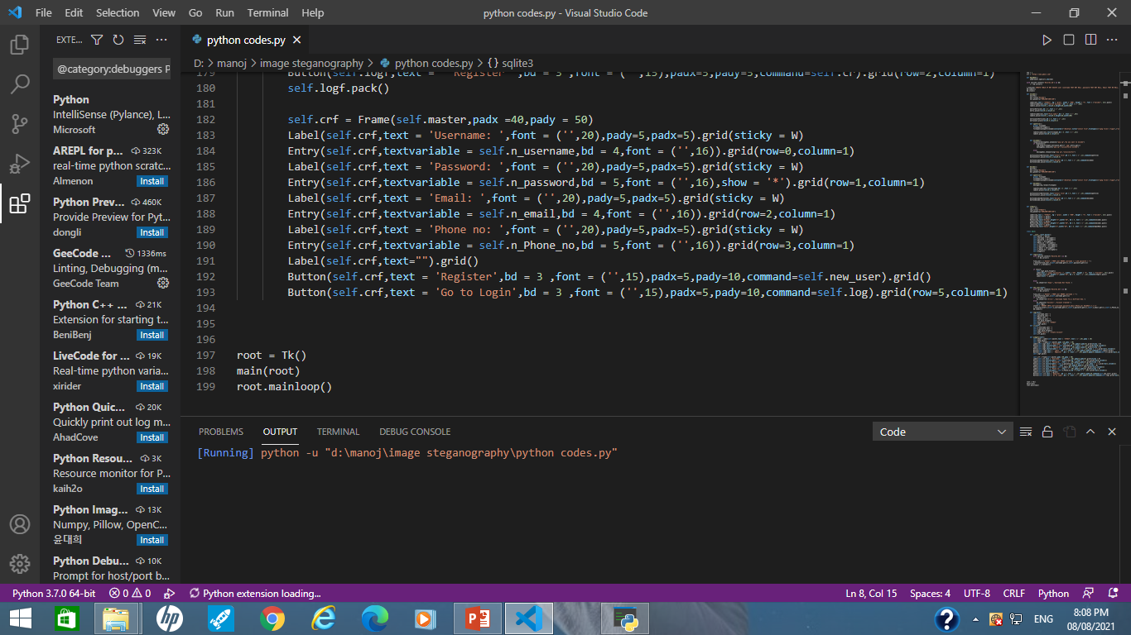

Slide 15
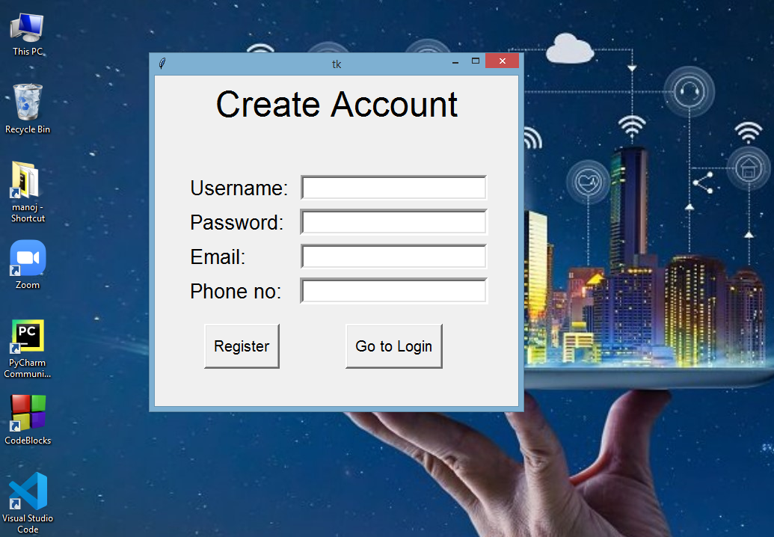
Sample output

Slide 16
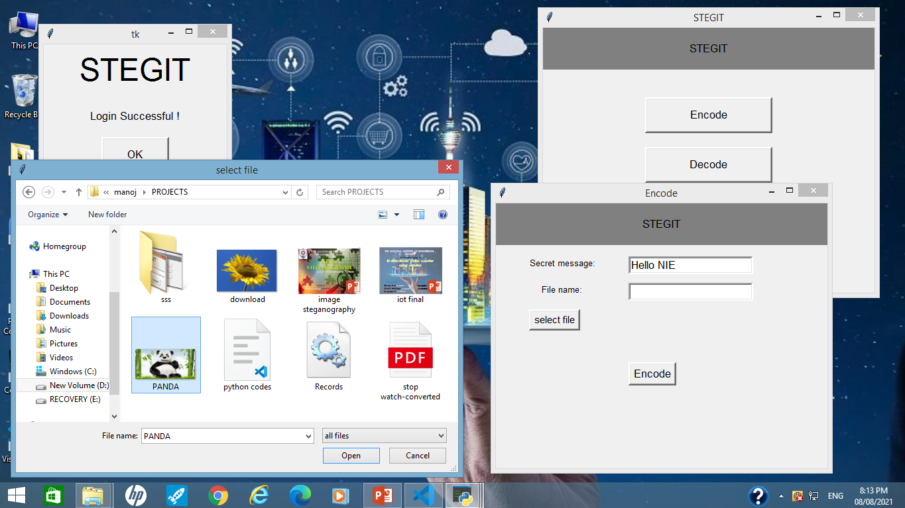

Slide 17
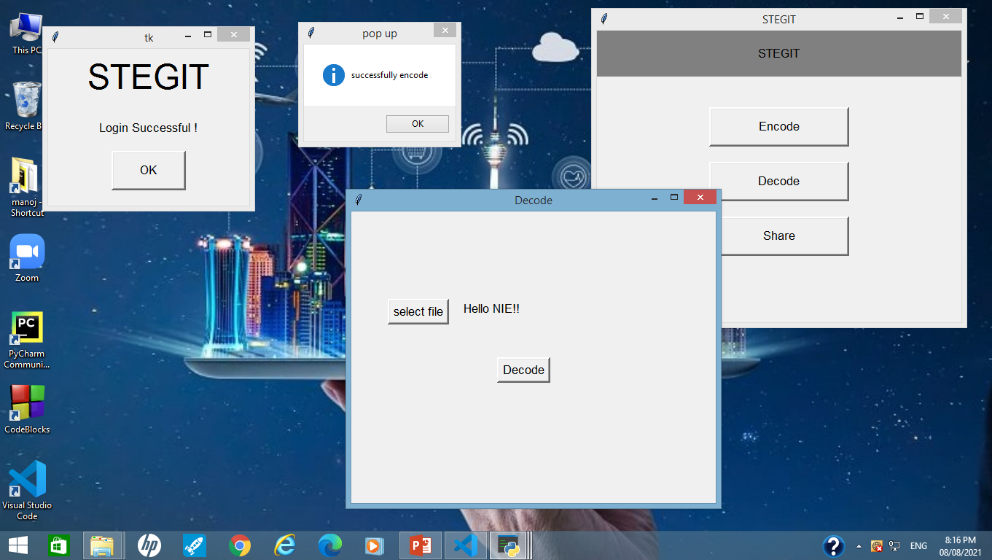

Slide 18
Advantages
Difficult to detect by someone who doesn't know about this
communication, whether the transaction is taking place or not.
In order to view the hidden message user should have to enter the secret
key which was generated using the steganographic algorithm.
Easy to implement with the help of LSB algorithm.
Can be used in arm forces and intelligence agencies.
Drawbacks
Sender and receiver should have the same software to encrypt or
decrypt message.
If encryption key is lost, then important information will be lost too.
The cover image used should have size greater than the message
bytes.
Hidden information can be viewed by attackers if proper encryption
algorithm used.
Encryption may effect luminance of the cover image.

Slide 19
Applications
Intelligence Agencies: security of person's private information .
Government Agencies: store critical data like criminal record .
Smart identity cards: personal information is embedded into photo .
Defence organisation: security from enemies .
Medical: patient's details are embedded within image .

Slide 20
Conclusion
Although only some of the main image steganographic techniques were discussed in this document, one can see that there exists a large selection of approaches to hiding information in images. All the major image file formats have different methods of hiding messages, with different strong and weak points respectively.
Used the Least Significant Bit algorithm in this project for developing the application which is faster and reliable and compression ratio is moderate compared to other algorithms.
Using python language makes easy for developing GUI and the LSB algorithm for encrypting and decrypting the information .
Future Recommendation
The major limitation of the application is designed for images cover files. It accepts only images as a carrier file.
The future work on this project is to improve the compression ratio of the image to the text. This project can be extended to a level such that it can be used for the different types of multimedia files.

Slide 21

Thank you

